Slide 1
OPTIMIZING
DIGITAL
MARKETING CAMPAIGN
CONVERSION PREDICTION
USING MACHINE LEARNING
NAVID MOHIYUDDIN SHAIKH

Slide 2
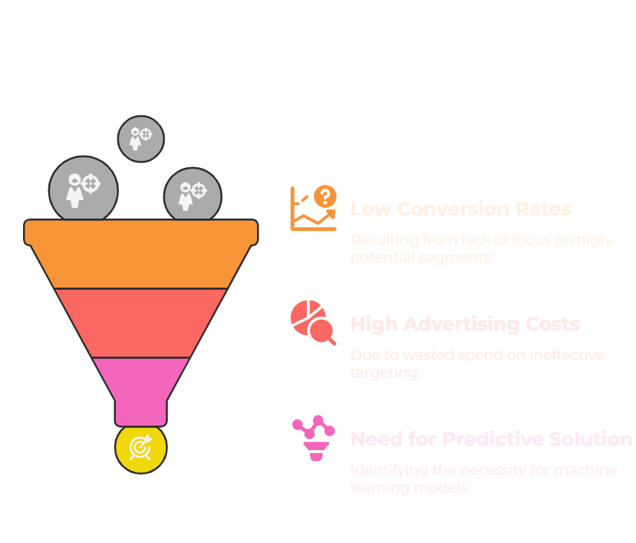
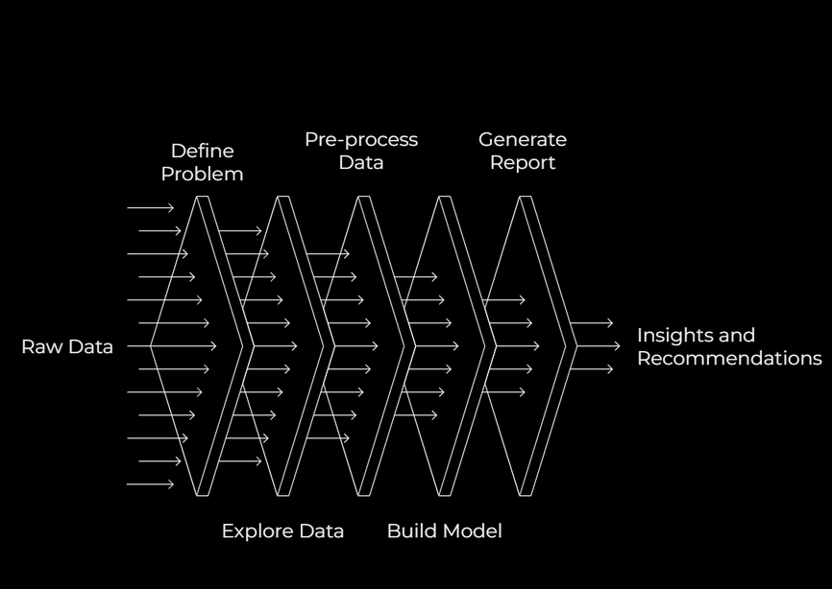
PROBLEM STATEMENT
The objective of this project is to develop a predictive machine learning model capable of determining whether a customer engaged in a digital marketing campaign will lead to a conversion—such as a purchase, signup, or other desired action. The dataset includes customer demographics, campaign performance metrics (e.g., Ad Spend, Click-Through Rate), and user behavior data (e.g., Website Visits, Time on Site). By accurately predicting conversion likelihood, model empowers marketing teams to allocate budgets more efficiently, target high-potential customers, and ultimately enhance the Return on Investment (ROI) of their digital marketing initiatives.

Slide 3
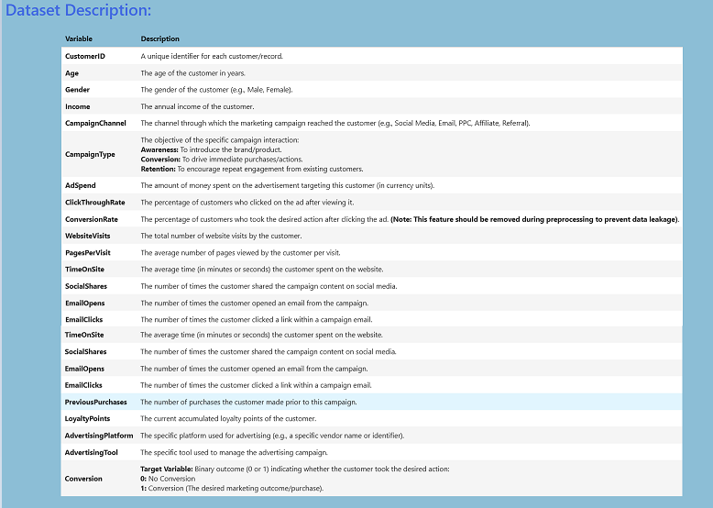
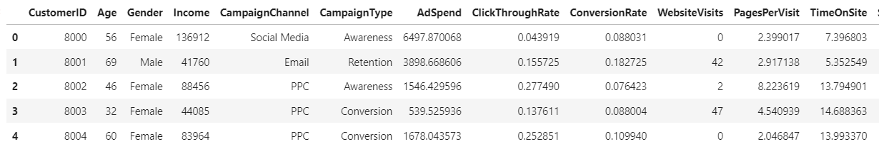
DATA DESCRIPTION
Dataset Description:
• Dataset Source: The dataset, contains customer data for predicting conversions in digital marketing campaigns.
• Feature Categories: Includes demographics (e.g., Age, Gender, Income) and engagement metrics (e.g., WebsiteVisits, EmailClicks) to capture customer behavior.
• Target Variable: The target, Conversion, is binary (0 = No Conversion, 1 = Converted), indicating whether a customer converted after a campaign.

Slide 4
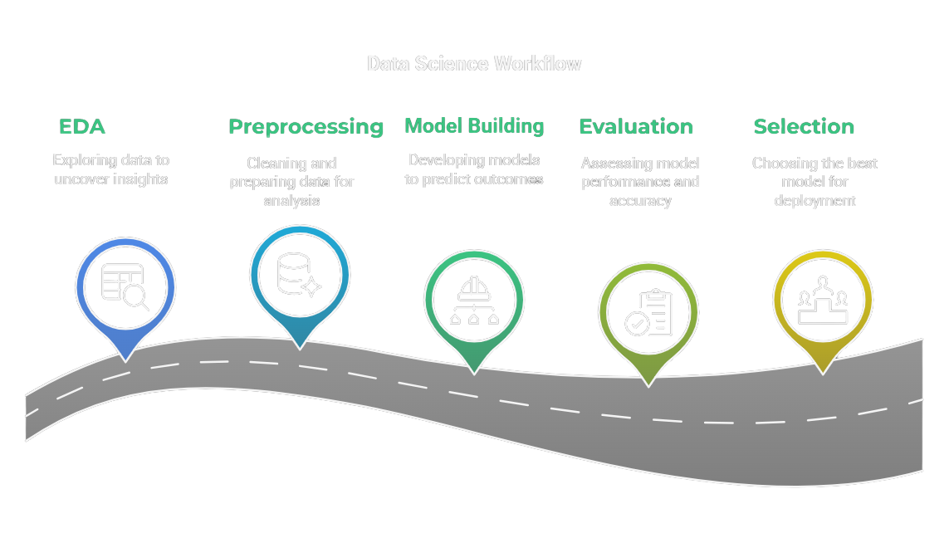
WORKFLOW

Slide 5
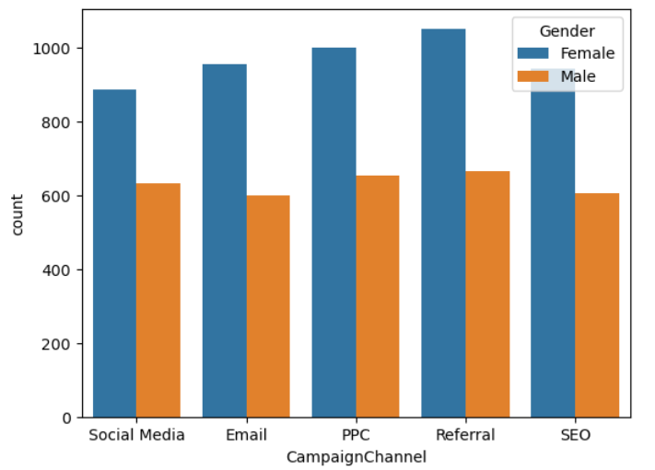
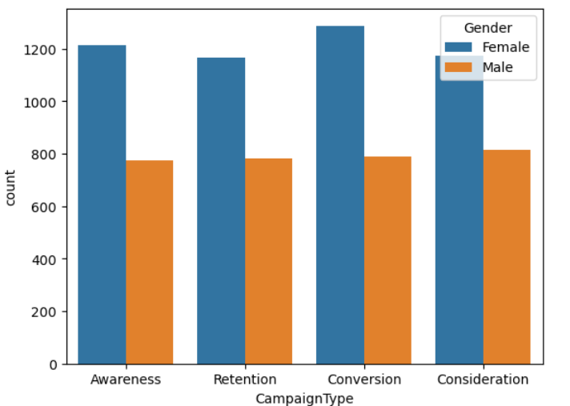
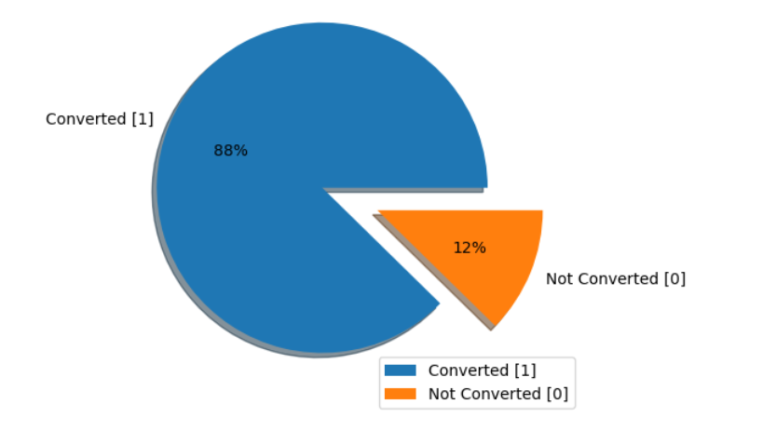
EXPLORATORY DATA ANALYSIS (EDA)
CUSTOMER DEMOGRAPHICS
Gender wise Distribution for Campaign Channels & Campaign type
Converted vs Not Converted
CUSTOMER ENGAMENT
Engagement Distribution
Website visit and Page per visit vs Campaign Type and Channel
Avg. Time on Site and Avg. loyalty point vs. Conversion
Percent of Returning Visitor
CAMPAGIN EFFECTIVENESS
Campaign Channel and Type Distribution
Ad. Spend and Click Through Rate Distribution
Click through Rate vs. Conversion
Campaign Type and Channel vs. Conversion
Total Ad. Spend vs. Conversion

Slide 6
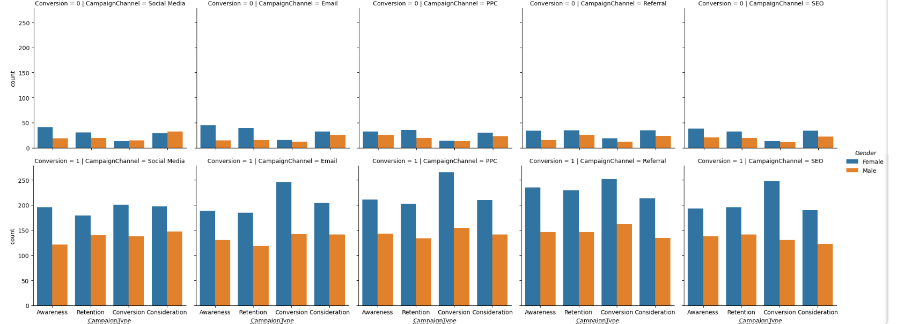
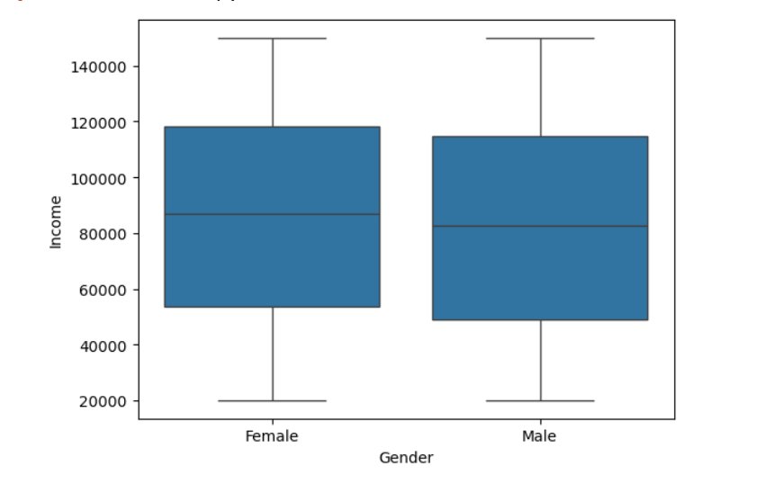
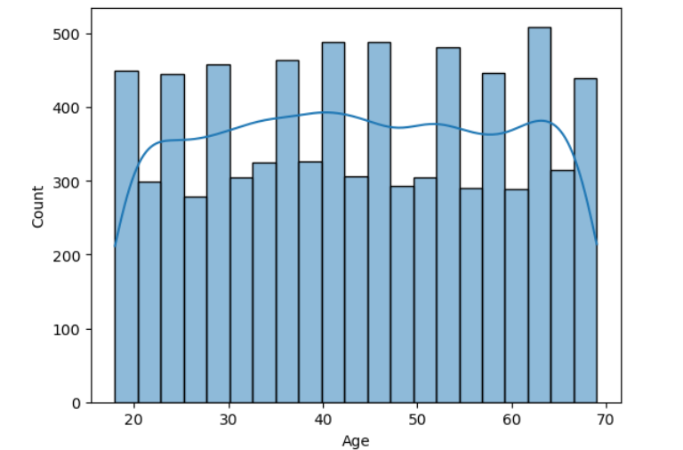
EXPLORATORY DATA ANALYSIS INSIGHTS
•Campaign Effectiveness: Accordingly, we can see for each campaign type female shows high conversions rate
•Channel Effectiveness: Similarly, we can see for each channel type female conversions leads to male counterparts
•Income distribution: There are no outliers in income distribution for each gender type.
•Age by Conversion Status: The histogram shows the frequency of different ages, while the KDE line provides a smoothed estimate of the age distribution for each conversion status.

Slide 7
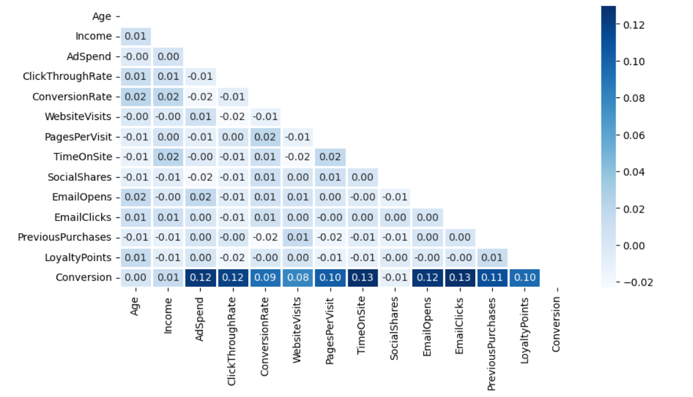
CORRELATION HEATMAP
Conversion Drivers: Conversion correlates most with TimeOnSite (0.13), AdSpend (0.12), ClickThroughRate (0.12), and PreviousPurchases (0.11), showing these features drive conversions.
Weak Correlations: Age, Income, and LoyaltyPoints show low correlations with Conversion (0.00-0.01), suggesting limited direct impact.

Slide 8
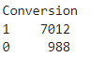
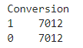
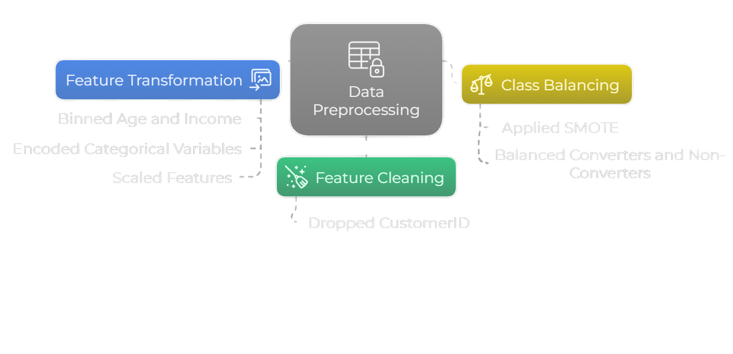
DATA PREPROCESSING
Feature Cleaning: Dropped CustomerID, AdvertisingPlatform, AdvertisingPlatform to focus on relevant conversion drivers.
Feature Transformation: Encoded categoricals (e.g., Gender), and scaled features with StandardScaler.
Class Balancing: Used SMOTETomek to balance Conversion, improving model performance on minority classes.
BEFORE SMOTETomek
AFTER SMOTE

Slide 9
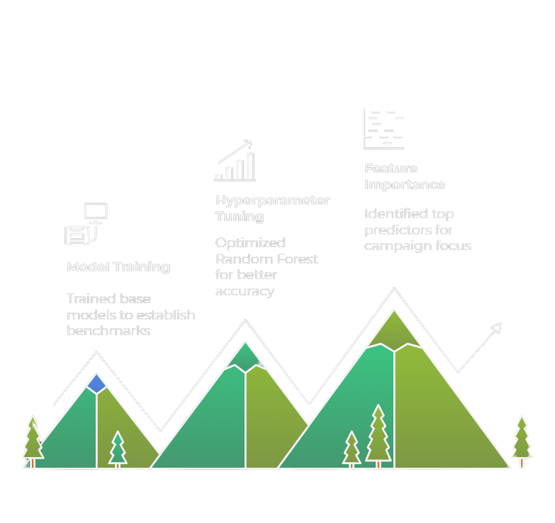
MODEL BULDING
Model Training: Trained base models including Logistic Regression, Decision Tree, Random Forest, SVC, XGBoost on the preprocessed dataset to establish initial performance.
Hyperparameter Tuning: Used GridSearchCV to optimize Random Forest, selecting n_estimators=250 and criterion=entropy
Feature Importance: Identified EmailClicks, TimeOnSite, and PreviousPurchases as top predictors, guiding campaign focus on engaged customers.

Slide 10
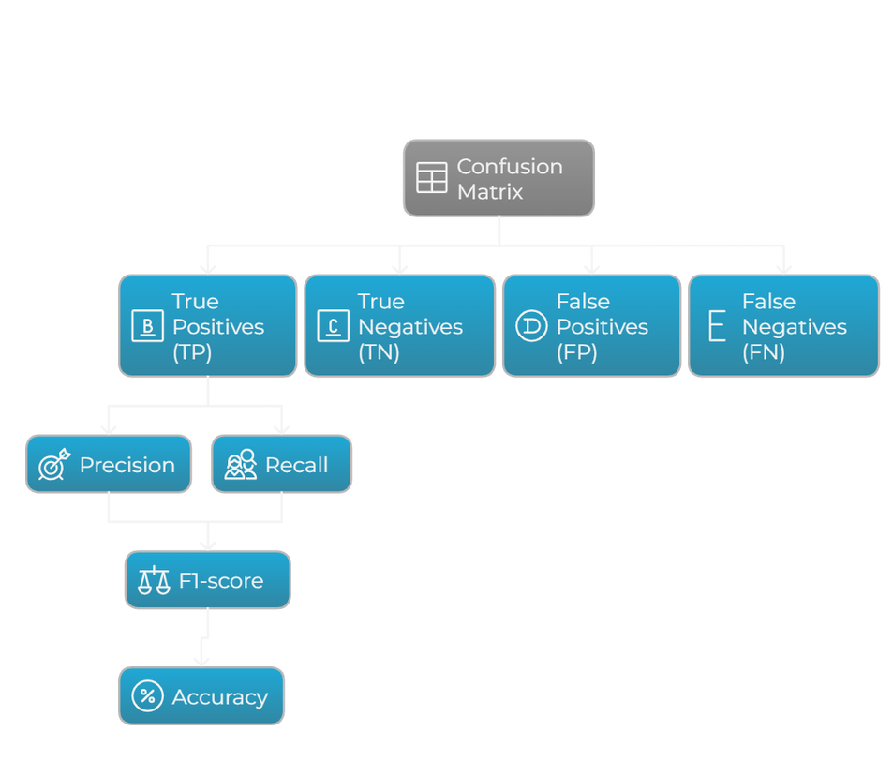
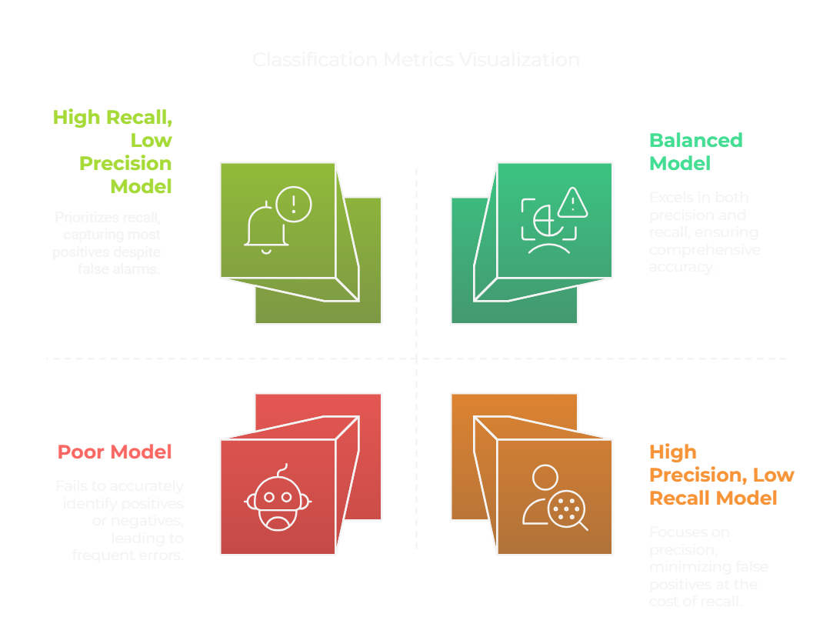
EVALUATION MATRIX

Slide 11
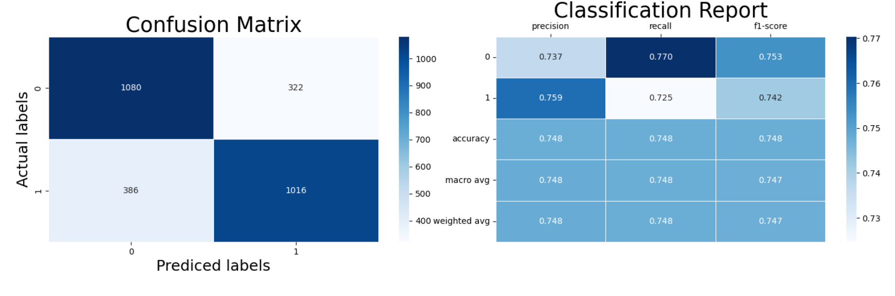
LOGISTIC REGRESSION EVALUATION
Logistic Regression : We can conclude from the Logistics regression that the model is able to predict accurately around 74% i.e 74% of the times the model is able to predict that is the consumer is getting converted or not.

Slide 12
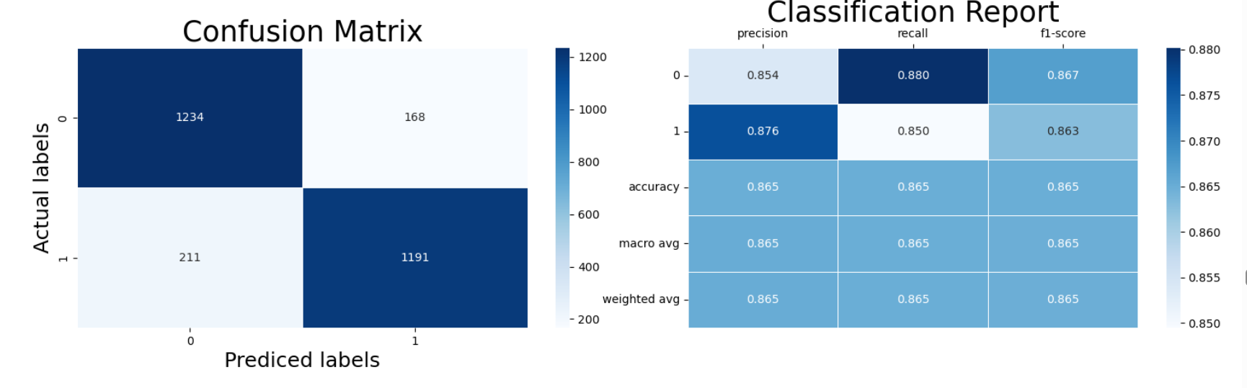
SVM CLASSIFIER EVALUATION
SVM Classifer : We can conclude that from using RandomaizedSearchCV the model is able to predict accurately around 84% i.e 84% of the times the model is able to predict that is the consumer is getting converted or not and the best parameter when using the SVC is 'rbf'

Slide 13

DECISION TREE EVALUATION
Decision Tree : We can conclude from the observation that criteria as entropy and with max depth of 200 we get the best result for Decision Tree with the accuracy of 87%

Slide 14
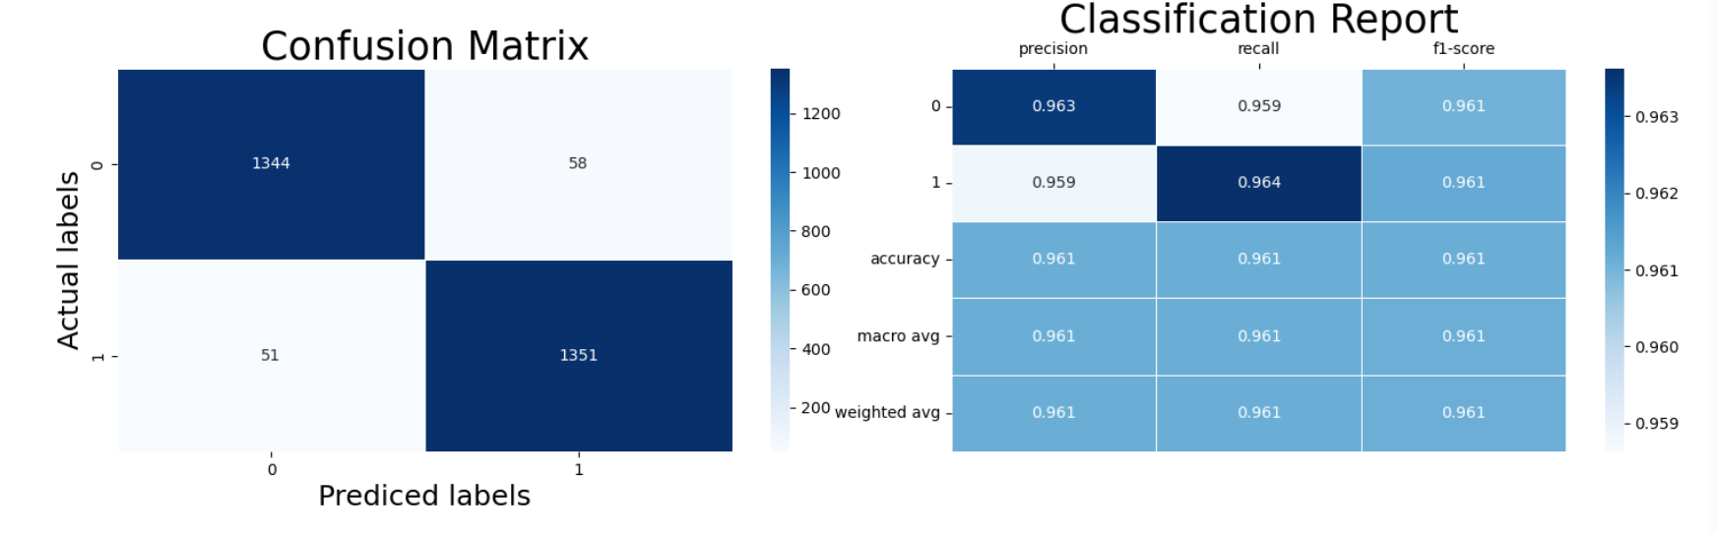
RANDOM FOREST EVALUATION
Random Forest : We can conclude from the observation that criteria as entropy and with max depth of 200 we get the best result for Random forest with the accuracy of 95%

Slide 15
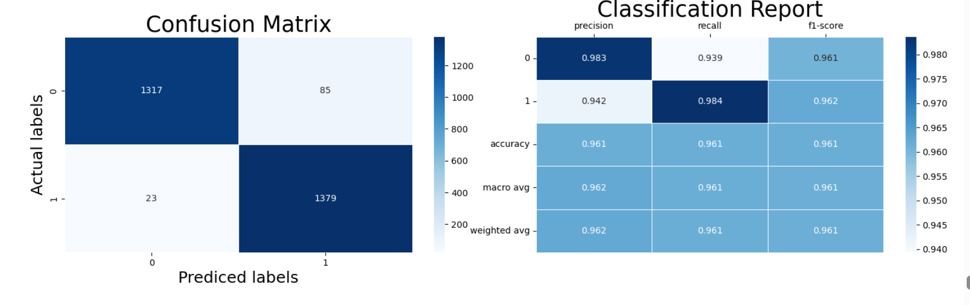
XG BOOST EVALUATION
XG Boost : We can conclude from the observation that the lossfunction of log_loss, the no of tress of 350 and with the learning rate of 0.1 gives the best results for XGBoost with the accuracy of 96%

Slide 16
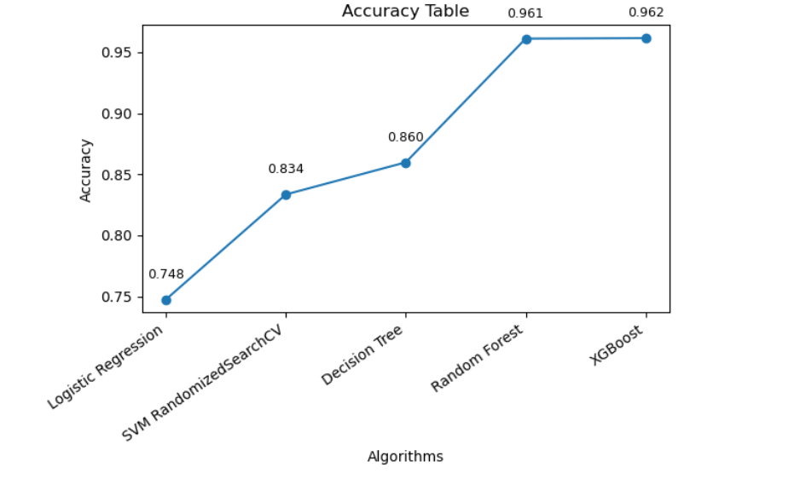
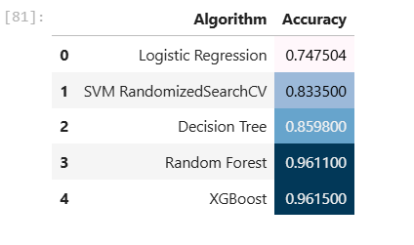
FINAL ACCURACY CHART
MODEL SELECTION
XG Boost : As per above visuals we can either select Random Forest or XG Boost for creation & use of ML Model

Slide 17
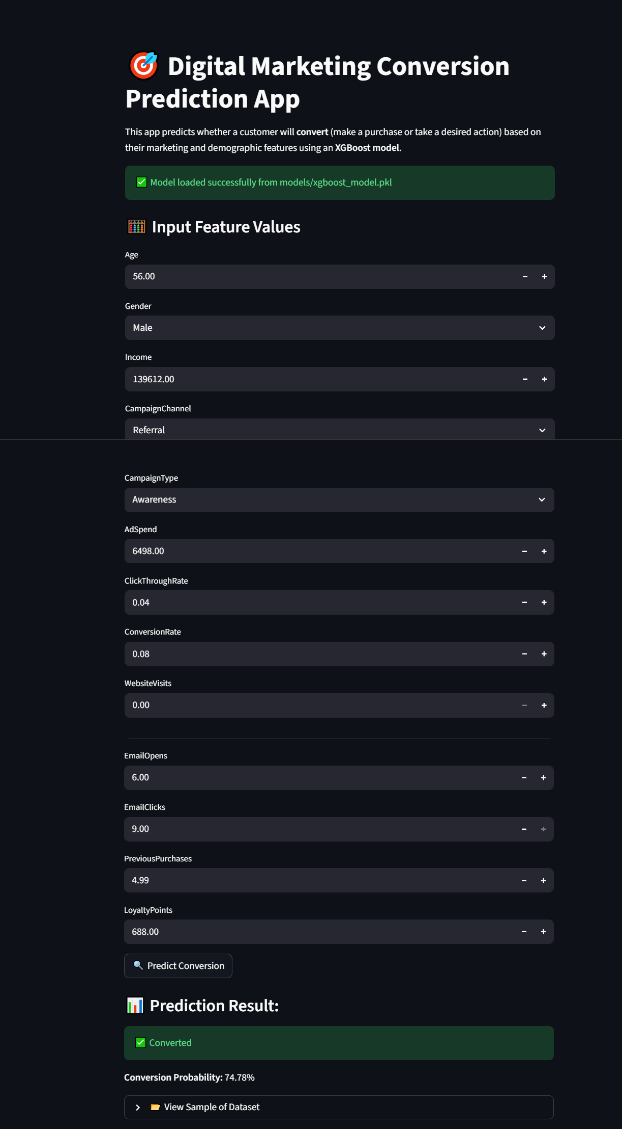
STREAMLIT WEB APP
Web APP : We can even make predictions on created model through stream lit web App

Slide 18
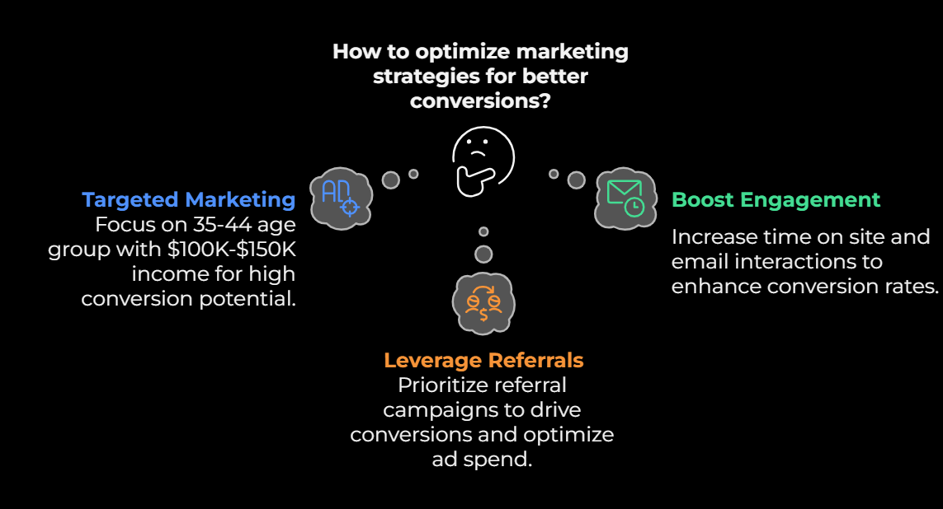
RECOMMENDATIONS

Slide 19
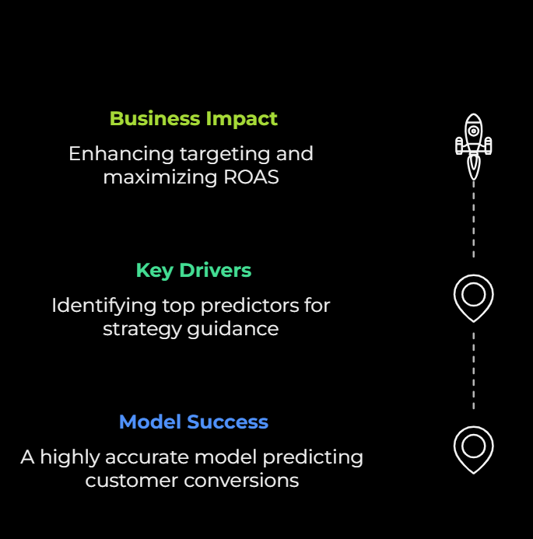
Conclusion
Model Success: XG Boost model achieved 96% accuracy, effectively predicting customer conversions for digital marketing campaigns.
Key Drivers: Identified EmailClicks and TimeOnSite as top predictors, guiding targeted strategies for higher conversions.
Business Impact: Enhances targeting, boosts conversion rates, and maximizes ROAS through data-driven campaign optimization.

Slide 20


